Slide 1
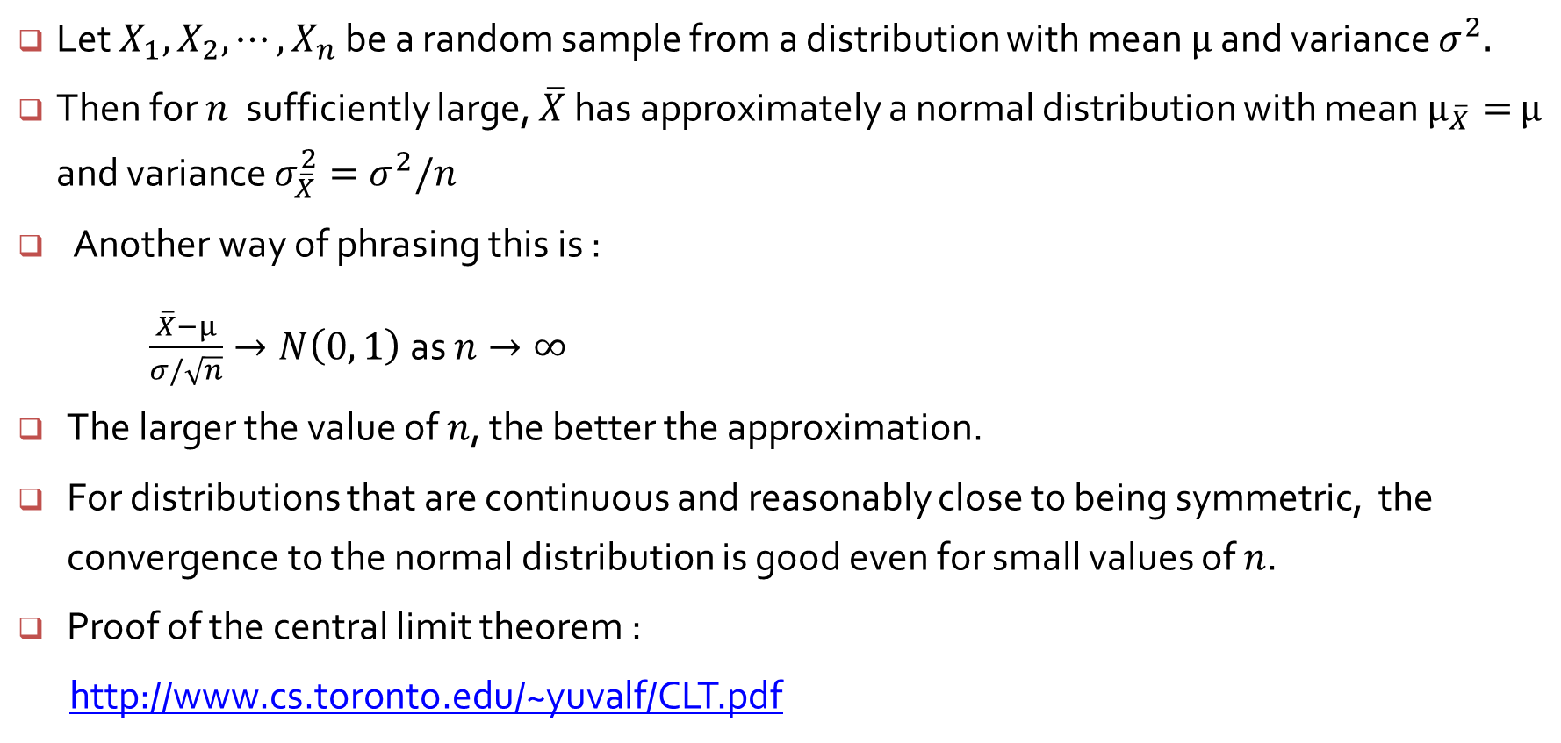
Central Limit Theorem
Let $X_{1},$ $X_{2},⋯, X_{n}$ be a random sample from a distribution with mean $μ$ and variance $σ^{2}.$
Then for $n$ sufficiently large, $\overline{X}$ has approximately a normal distribution with mean $μ_{\overline{X}}=$ $μ$ and variance $σ_{\overline{X}}^{2}=$ $σ^{2}/n$
Another way of phrasing this is :
$\frac{\overline{X}−μ}{σ/\sqrt{n}}→N\left(0, 1\right)$ as $n→∞$
The larger the value of $n$, the better the approximation.
For distributions that are continuous and reasonably close to being symmetric, the convergence to the normal distribution is good even for small values of $n$.
Proof of the central limit theorem :
http://www.cs.toronto.edu/~yuvalf/CLT.pdf

Slide 2
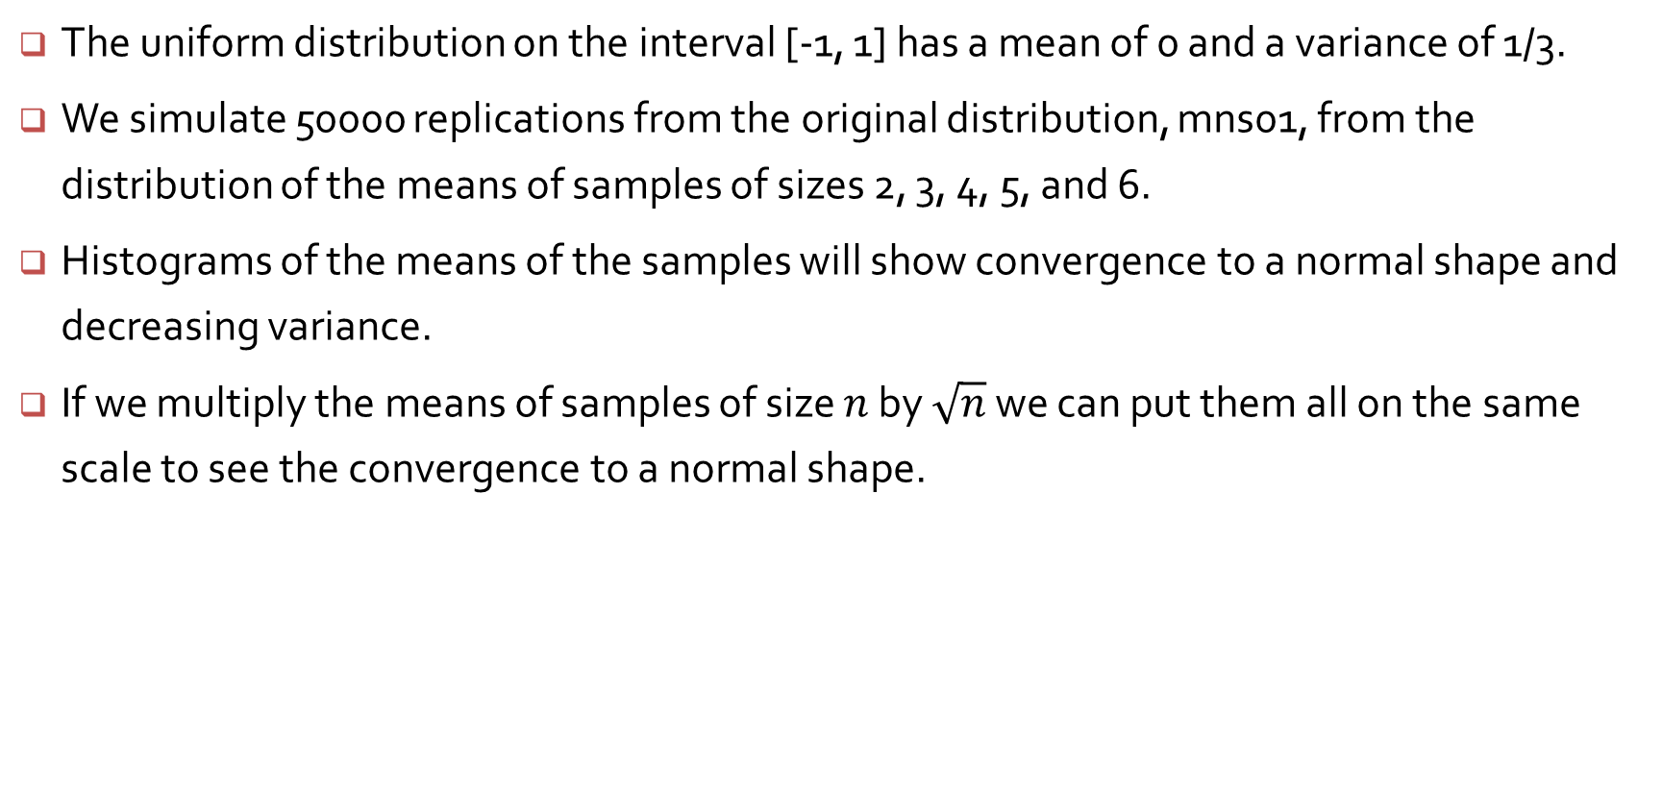
Convergence of means from U[-1, 1] to a normal shape
The uniform distribution on the interval [-1, 1] has a mean of 0 and a variance of 1/3.
We simulate 50000 replications from the original distribution, mns01, from the distribution of the means of samples of sizes 2, 3, 4, 5, and 6.
Histograms of the means of the samples will show convergence to a normal shape and decreasing variance.
If we multiply the means of samples of size $n$ by $\sqrt{n}$ we can put them all on the same scale to see the convergence to a normal shape.

Slide 3
# Simulating a sample mean from a Uniform
> k=10000
> mns1 = mns2 = mns3 = mns4 = mns5 = mns6 = numeric(k)
> for(i in 1:k) {
+ mns1[i]=mean(runif(1, -1, 1))
+ mns2[i]=mean(runif(2, -1, 1))
+ mns3[i]=mean(runif(3, -1, 1))
+ mns4[i]=mean(runif(4, -1, 1))
+ mns5[i]=mean(runif(5, -1, 1))
+ mns6[i]=mean(runif(6, -1, 1))
+ }
> histogram(~mns1 + mns2 + mns3 + mns4 + mns5 + mns6, nint = 50)
> densityplot(~mns1 + mns2 + mns3 + mns4 + mns5 + mns6, plot.points = F)

Slide 4
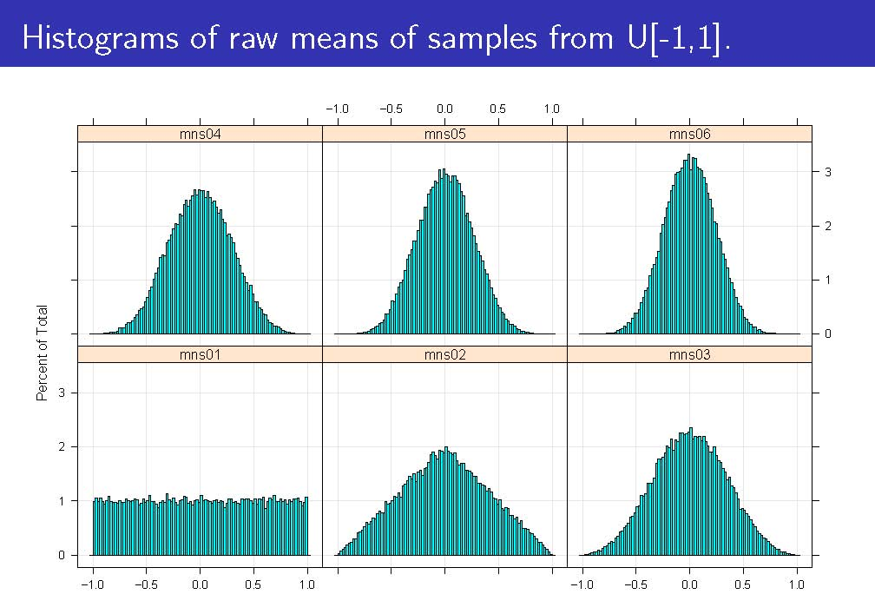

Slide 5
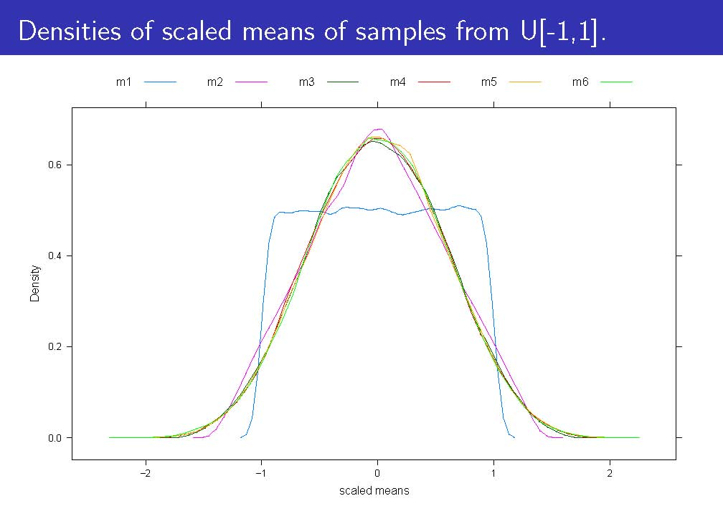

Slide 6
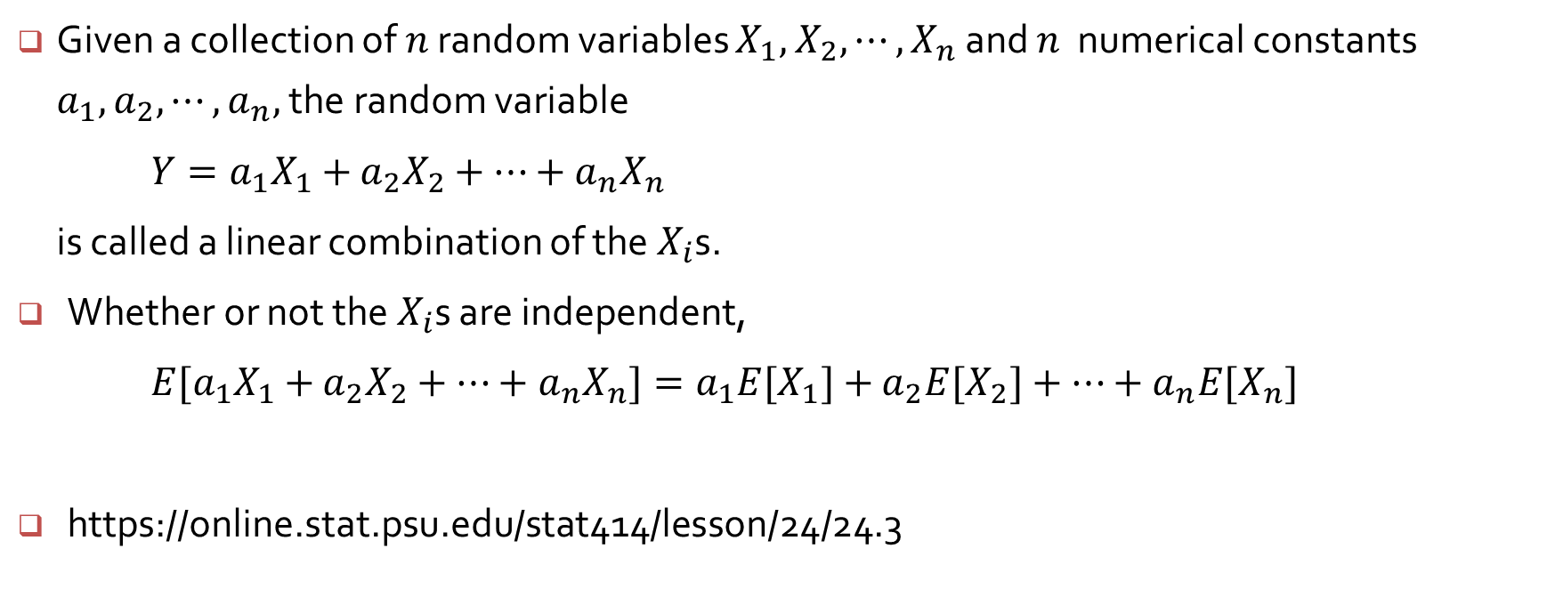
Linear Combinations and their means
Given a collection of $n$ random variables $X_{1},$ $X_{2},⋯, X_{n}$ and $n$ numerical constants $a_{1},$ $a_{2},⋯, a_{n},$the random variable
$Y=a_{1}X_{1}+$ $a_{2}X_{2}+⋯+a_{n}X_{n}$
is called a linear combination of the $X_{i}$s.
Whether or not the $X_{i}$s are independent,
$E[a_{1}X_{1}+$ $a_{2}X_{2}+⋯+a_{n}X_{n}]=a_{1}{E[X}_{1}]+$ $a_{2}{E[X}_{2}]+⋯+a_{n}{E[X}_{n}]$
https://online.stat.psu.edu/stat414/lesson/24/24.3

Slide 7
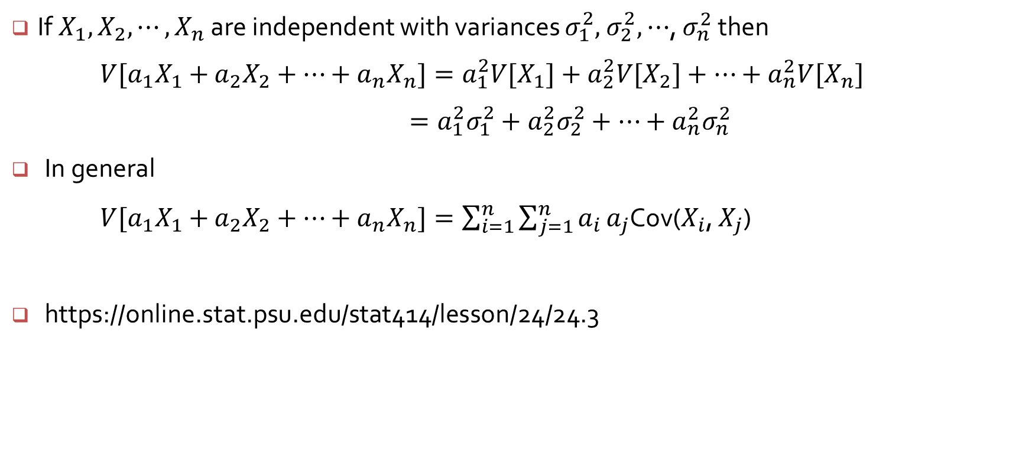
Variances of Linear Combinations
If$X_{1},$ $X_{2},⋯, X_{n}$ are independent with variances $σ_{1}^{2},$ $σ_{2}^{2},$ $⋯$, $σ_{n}^{2}$ then
$V[a_{1}X_{1}+$ $a_{2}X_{2}+⋯+a_{n}X_{n}]=a_{1}^{2}{V[X}_{1}]+a_{2}^{2}{V[X}_{2}]+⋯+a_{n}^{2}{V[X}_{n}]$
$=a_{1}^{2}σ_{1}^{2}+a_{2}^{2}σ_{2}^{2}+⋯+a_{n}^{2}σ_{n}^{2}$
In general
$V[a_{1}X_{1}+$ $a_{2}X_{2}+⋯+a_{n}X_{n}]=\sum_{i=1}^{n}{\sum_{j=1}^{n}{a_{i}}}a_{j}$Cov($X_{i}$, $X_{j}$)
https://online.stat.psu.edu/stat414/lesson/24/24.3

Slide 8
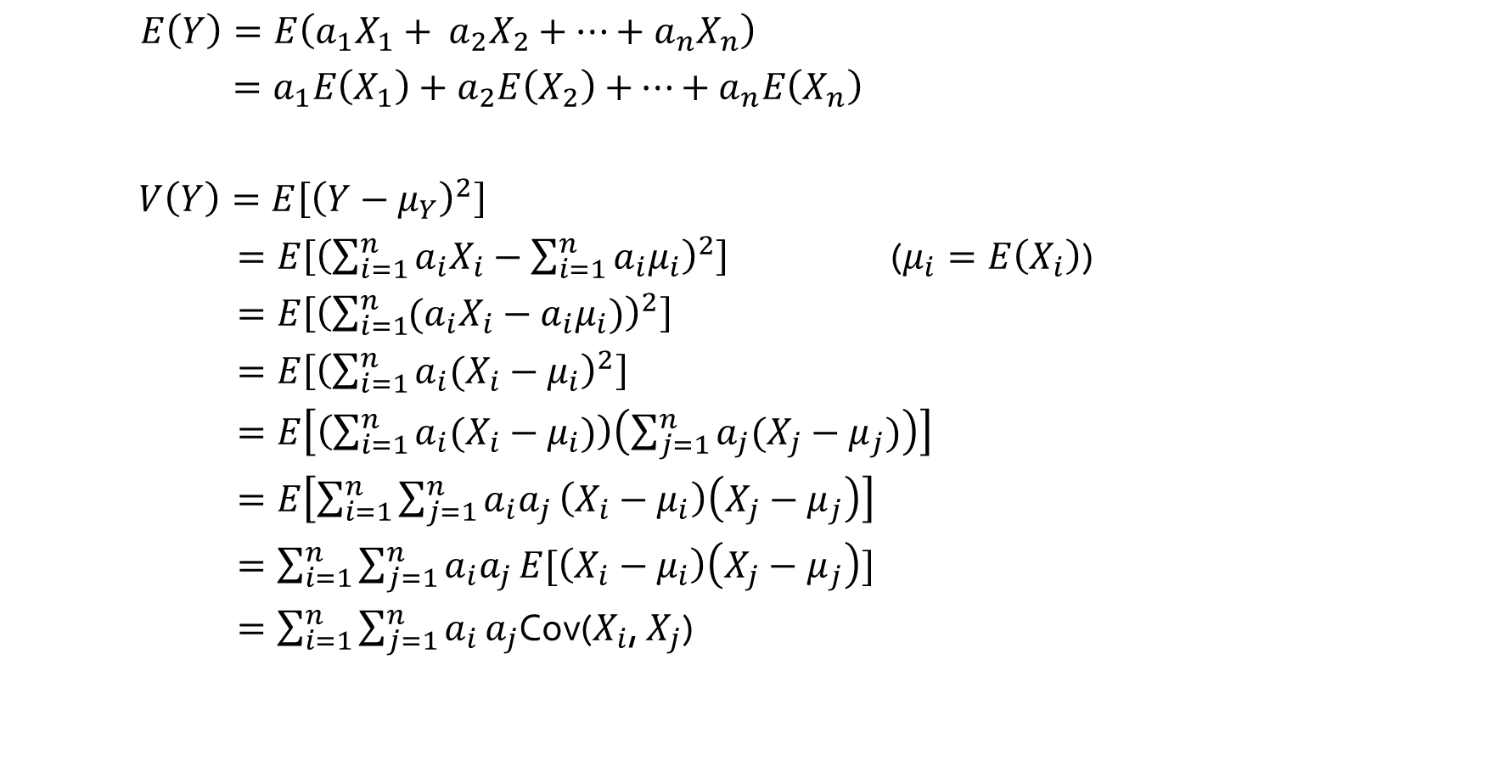
$E\left(Y\right)=E\left(a_{1}X_{1}+ a_{2}X_{2}+⋯+a_{n}X_{n}\right)$
$=a_{1}E\left(X_{1}\right)+a_{2}E\left(X_{2}\right)+$ $⋯+a_{n}E\left(X_{n}\right)$
$V\left(Y\right)=E\left[{\left(Y−μ_{Y}\right)}^{2}\right]$
$=E\left[{\left(\sum_{i=1}^{n}{a_{i}X_{i}}−\sum_{i=1}^{n}{a_{i}μ_{i}}\right)}^{2}\right]$ ($μ_{i}=E\left(X_{i}\right)$)
$=E\left[{\left(\sum_{i=1}^{n}{{(a}_{i}X_{i}}−a_{i}μ_{i})\right)}^{2}\right]$
$=E\left[{\left(\sum_{i=1}^{n}{a_{i}(X_{i}}−μ_{i}\right)}^{2}\right]$
$=E\left[\left(\sum_{i=1}^{n}{a_{i}(X_{i}}−μ_{i})\right)\left(\sum_{j=1}^{n}{a_{j}(X_{j}}−μ_{j})\right)\right]$
$=E\left[\sum_{i=1}^{n}{\sum_{j=1}^{n}{a_{i}a_{j}}}\left(X_{i}−μ_{i}\right)\left(X_{j}−μ_{j}\right)\right]$
$=\sum_{i=1}^{n}{\sum_{j=1}^{n}{a_{i}a_{j}}}E[\left(X_{i}−μ_{i}\right)\left(X_{j}−μ_{j}\right)]$
$=\sum_{i=1}^{n}{\sum_{j=1}^{n}{a_{i}}}a_{j}$Cov($X_{i}$, $X_{j}$)

Slide 9
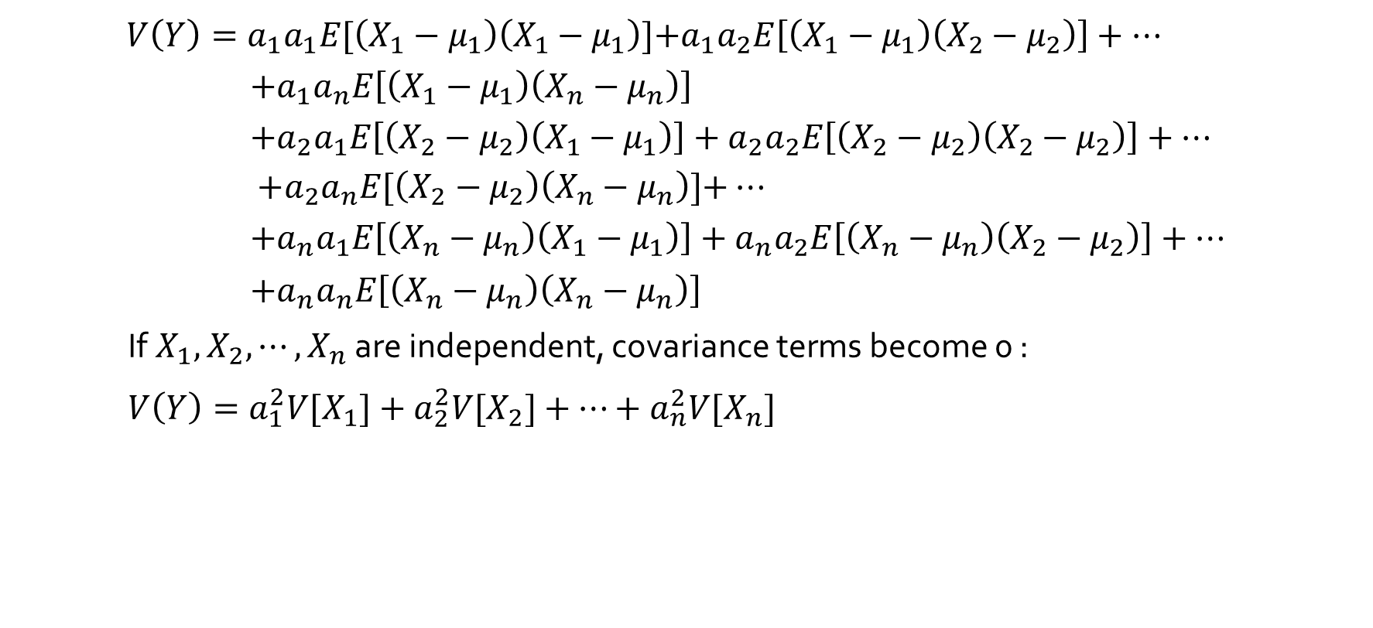
$V\left(Y\right)=a_{1}a_{1}E[\left(X_{1}−μ_{1}\right)\left(X_{1}−μ_{1}\right)]$+$a_{1}a_{2}E\left[\left(X_{1}−μ_{1}\right)\left(X_{2}−μ_{2}\right)\right]+⋯$
$+a_{1}a_{n}E\left[\left(X_{1}−μ_{1}\right)\left(X_{n}−μ_{n}\right)\right]$
+$a_{2}a_{1}E\left[\left(X_{2}−μ_{2}\right)\left(X_{1}−μ_{1}\right)\right]+a_{2}a_{2}E\left[\left(X_{2}−μ_{2}\right)\left(X_{2}−μ_{2}\right)\right]+⋯$
$+a_{2}a_{n}E[\left(X_{2}−μ_{2}\right)\left(X_{n}−μ_{n}\right)]$+ $⋯$
+$a_{n}a_{1}E\left[\left(X_{n}−μ_{n}\right)\left(X_{1}−μ_{1}\right)\right]+a_{n}a_{2}E\left[\left(X_{n}−μ_{n}\right)\left(X_{2}−μ_{2}\right)\right]+⋯$
$+a_{n}a_{n}E\left[\left(X_{n}−μ_{n}\right)\left(X_{n}−μ_{n}\right)\right]$
If$X_{1},$ $X_{2},⋯, X_{n}$ are independent, covariance terms become 0 :
$V\left(Y\right)=a_{1}^{2}{V[X}_{1}]+a_{2}^{2}{V[X}_{2}]+⋯+a_{n}^{2}{V[X}_{n}]$

Slide 10
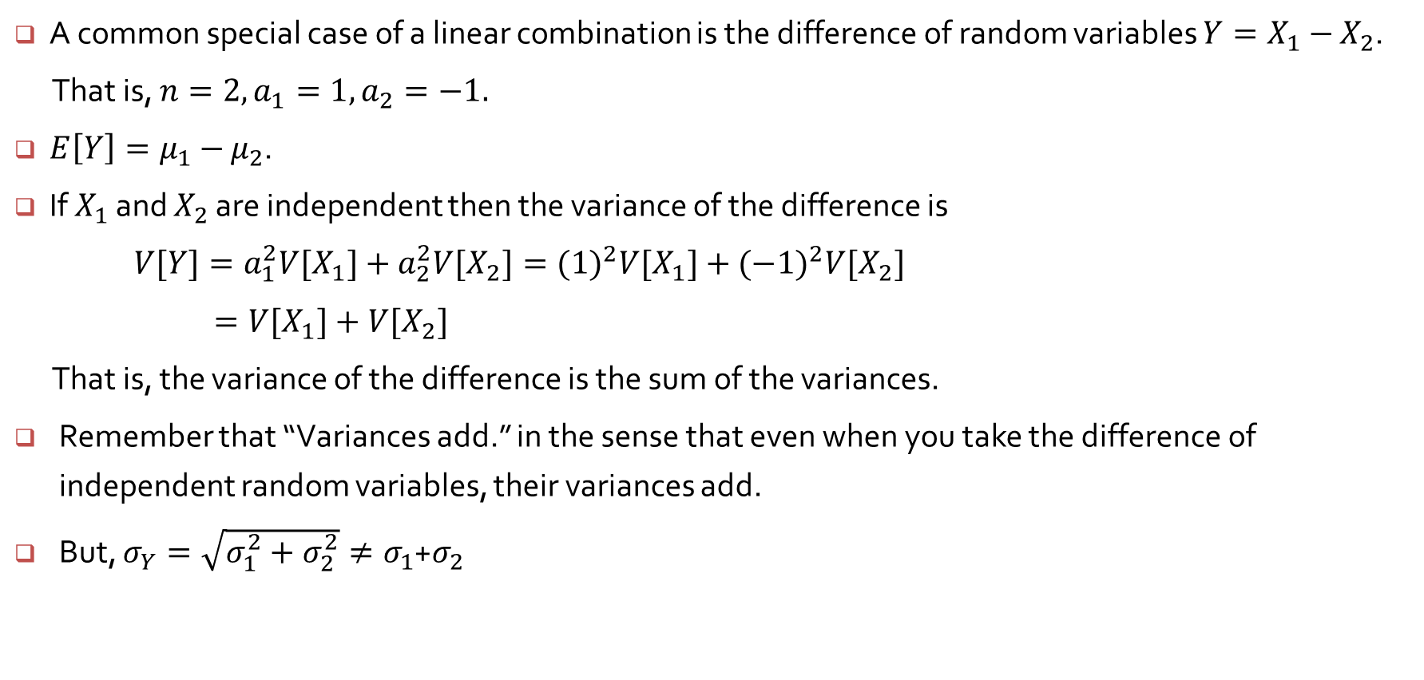
The difference between random variables
A common special case of a linear combination is the difference of random variables $Y=X_{1}−$ $X_{2}$.
That is, $n=2, a_{1}=1, a_{2}=−1.$
${E\left[Y\right]=μ}_{1}−$ $μ_{2}$.
If $X_{1}$ and $X_{2}$ are independent then the variance of the difference is
$V[Y]=a_{1}^{2}{V[X}_{1}]+a_{2}^{2}{V[X}_{2}]={(1)}^{2}{V[X}_{1}]+{(−1)}^{2}{V[X}_{2}]$
$={V[X}_{1}]+{V[X}_{2}]$
That is, the variance of the difference is the sum of the variances.
Remember that “Variances add.” in the sense that even when you take the difference of independent random variables, their variances add.
But, $σ_{Y}=\sqrt{σ_{1}^{2}+σ_{2}^{2}}≠σ_{1}$+$σ_{2}$

Slide 11
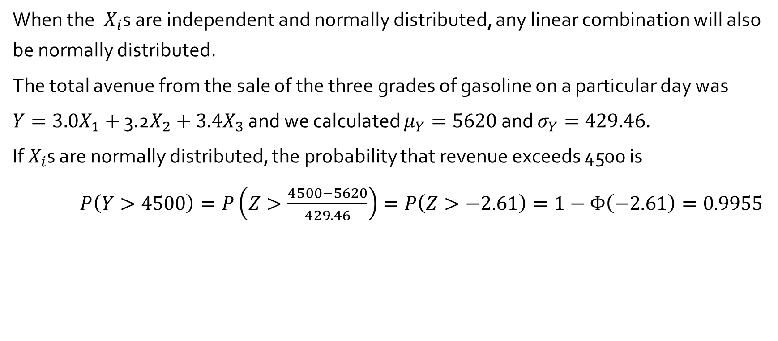
The Case of Normal Random Variables : Example 5.31
When the $X_{i}$s are independent and normally distributed, any linear combination will also be normally distributed.
The total avenue from the sale of the three grades of gasoline on a particular day was
$Y={3.0X}_{1}+$ 3.2$X_{2}+3.4X_{3}$ and we calculated $μ_{Y}=5620$ and $σ_{Y}=429.46$.
If $X_{i}$s are normally distributed, the probability that revenue exceeds 4500 is
$P\left(Y>4500\right)=P\left(Z>\frac{4500−5620}{429.46}\right)=P\left(Z>−2.61\right)=1−Φ\left(−2.61\right)=0.9955$

Slide 12
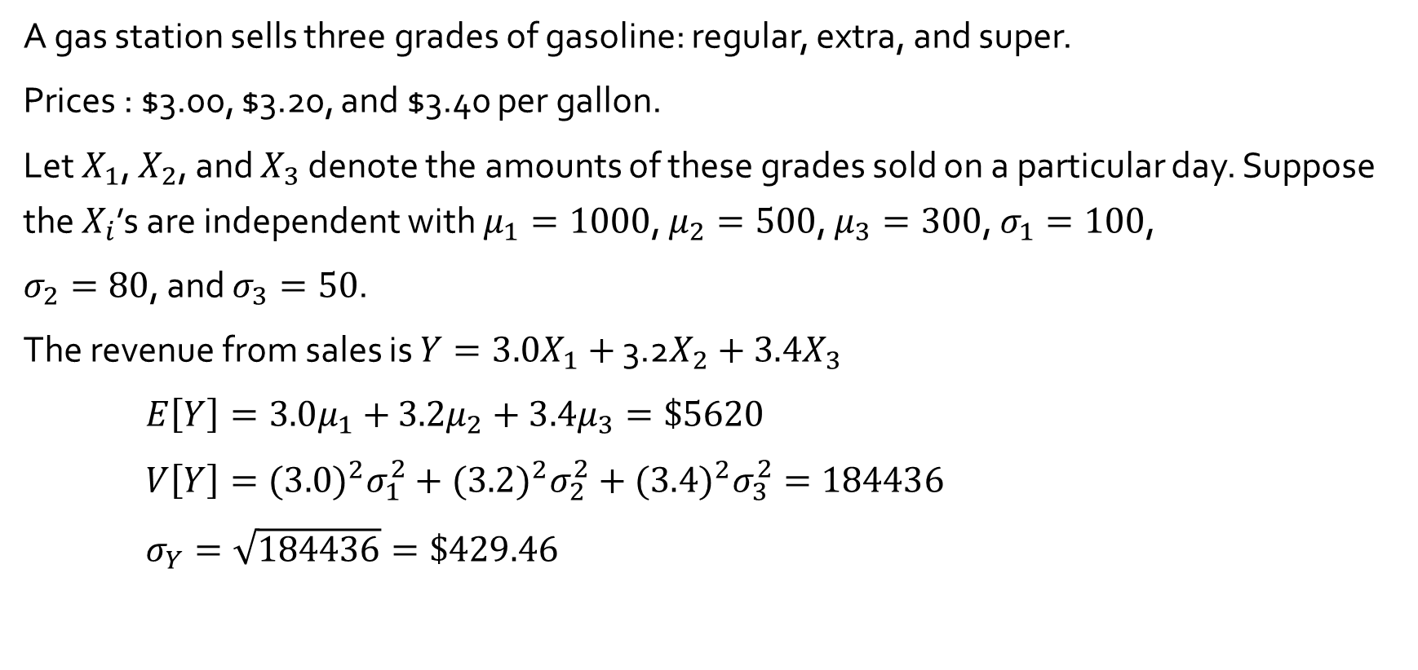
Properties of sample mean and sample sum : Example 5.29
A gas station sells three grades of gasoline: regular, extra, and super.
Prices : $3.00, $3.20, and $3.40 per gallon.
Let $X_{1}$, $X_{2}$, and $X_{3}$ denote the amounts of these grades sold on a particular day. Suppose the $X_{i}$’s are independent with $μ_{1}=1000$, $μ_{2}=500$, $μ_{3}=300$, $σ_{1}=100$,
$σ_{2}=80$, and $σ_{3}=50$.
The revenue from sales is $Y={3.0X}_{1}+$ 3.2$X_{2}+3.4X_{3}$
$E\left[Y\right]=3.0μ_{1}+$ $3.2μ_{2}+$ $3.4μ_{3}=\$5620$
$V\left[Y\right]={(3.0)}^{2}σ_{1}^{2}+{(3.2)}^{2}σ_{2}^{2}+{(3.4)}^{2}σ_{3}^{2}=184436$
$σ_{Y}=\sqrt{184436}=\$429.46$

